Slide 1
MIE-311 Mobile Network Security
Zhe XuanYuan (轩辕哲)
xuanyuanz@mail.sysu.edu.cn

Slide 2
Lecture 8: Firewalls
Introduce several types of firewalls
Discuss their advantages and disadvantages
Compare their performances
Demonstrate their applications

Slide 3
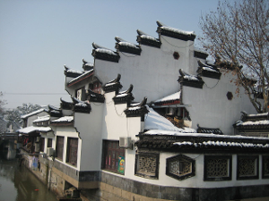
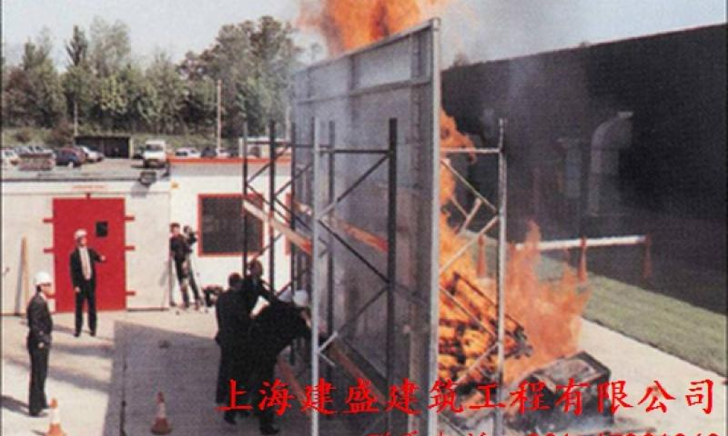
What is a Firewall
防火墙是由不燃烧体构成，耐火极限不低于3h。为减小或避免建筑、结构、设备遭受热辐射危害和防止火灾蔓延，设置的竖向分隔体或直接设置在建筑物基础上或钢筋混凝土框架上具有耐火性的墙。

Slide 4
What is a Firewall?
A firewall is a system of hardware and software components designed to restrict access between or among networks, most often between the Internet and a private Internet.
The firewall is part of an overall security policy that creates a perimeter defense designed to protect the information resources of the organization.

Slide 5
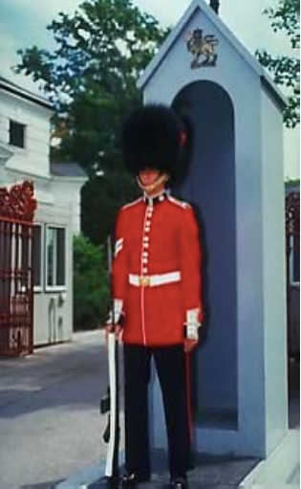
In other words...
“A data sentry at the gateway to your network, combining the power of multiple firewall technologies to deliver powerful perimeter security”

Slide 6
What a Firewall does
Implement security policies at a single point
Monitor security-related events (audit, log)
Provide strong authentication
Allow virtual private networks

Slide 7
What a Firewall does not do
Protect against attacks that bypass the firewall
Protect against internal threats
disgruntled employee
Insider cooperates with an external attacker
Protect against the transfer of virus- infected programs or files

Slide 8
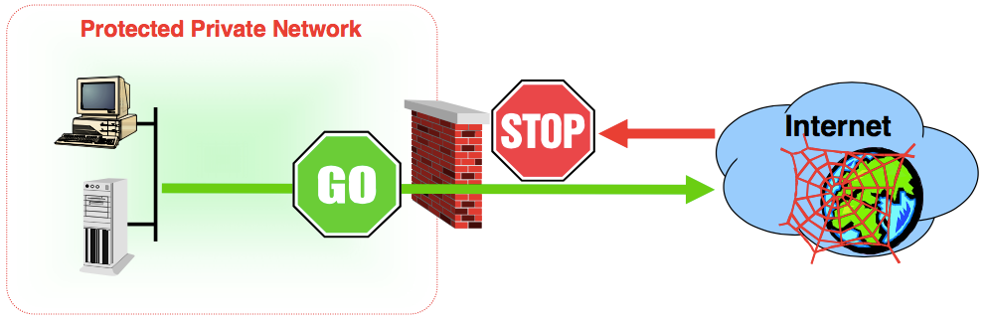
Firewall - Typical Layout
A firewall denies or permits access based on policies and rules

Slide 9
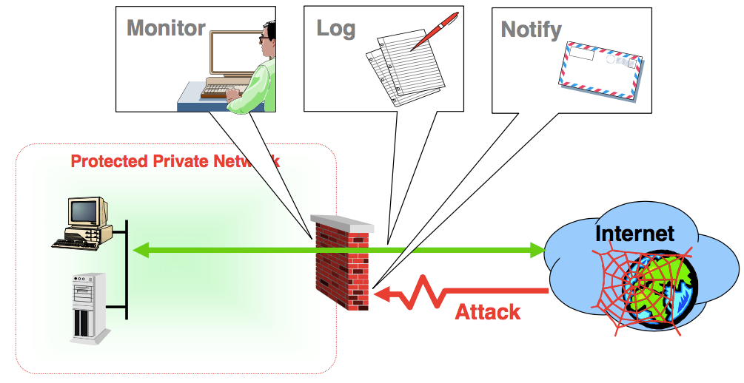
Watching for attacks

Slide 10
Firewall Technologies
Common firewall technologies, four categories:
Packet Filtering Firewalls
Circuit Level Firewalls
Application Gateway Firewalls (or proxy servers)
Stateful Inspection Firewalls (dynamic packet filtering firewalls)
These technologies operate at different levels of detail, providing varying degrees of network access protection.
These technologies are not mutually exclusive as some firewall products may implement several of these technologies simultaneously.

Slide 11
Packet Filtering Firewalls
The original firewall
Works at the network level
Applies packet filters based on access rules
Source address
Destination address
Application or protocol
Source port number
Destination port number

Slide 12
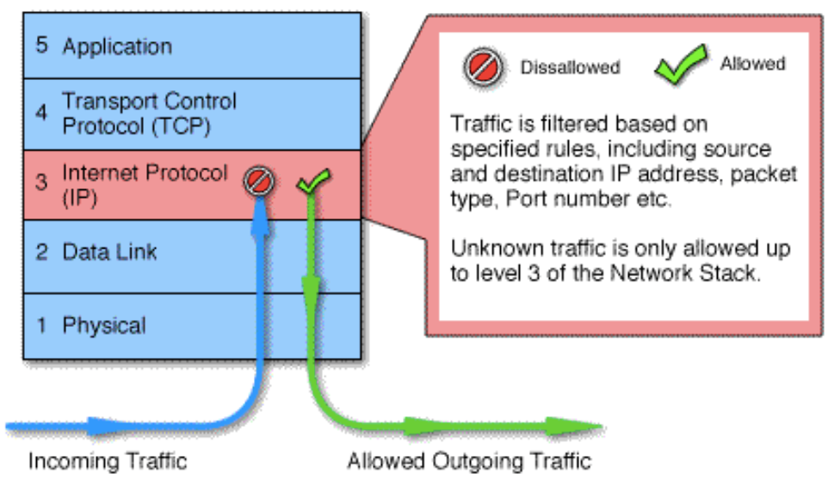
Packet Filtering Firewalls

Slide 13
Packet Filtering Firewalls
Packet Filtering is usually an integrated function of a router.
Packet filtering relies on Network Layer and Transport Layer information contained in the headers of data packets to police traffic.
This information includes: source IP address and port number, destination IP address and port number, and protocol used (e.g., TCP, UDP)
This information is used as the criteria in network access rules. These rules are organized into several “filter sets” and each set handles traffic coming to the firewall over a specific interface.

Slide 14
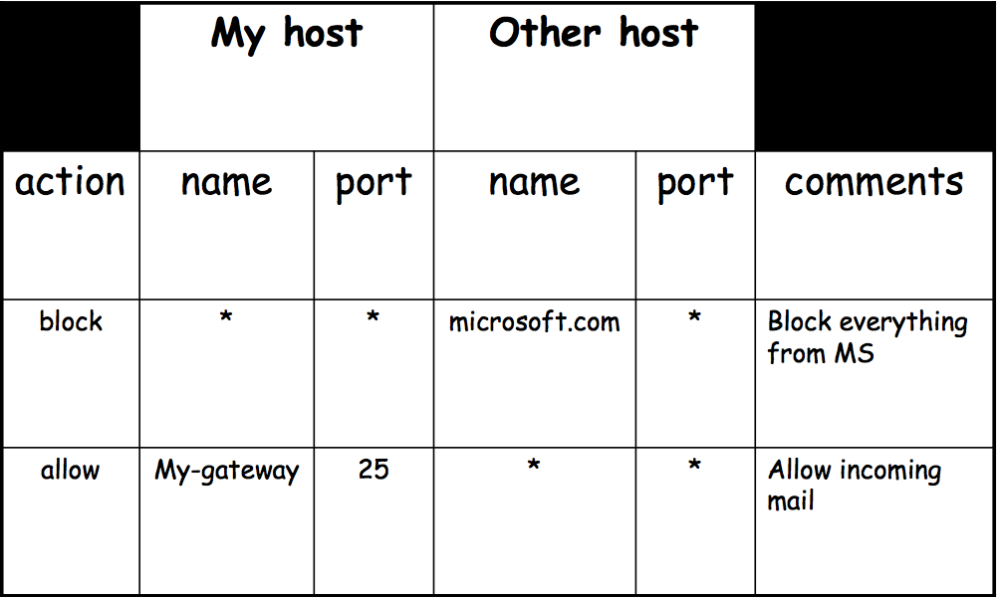
Packet Filtering Policy Example

Slide 15
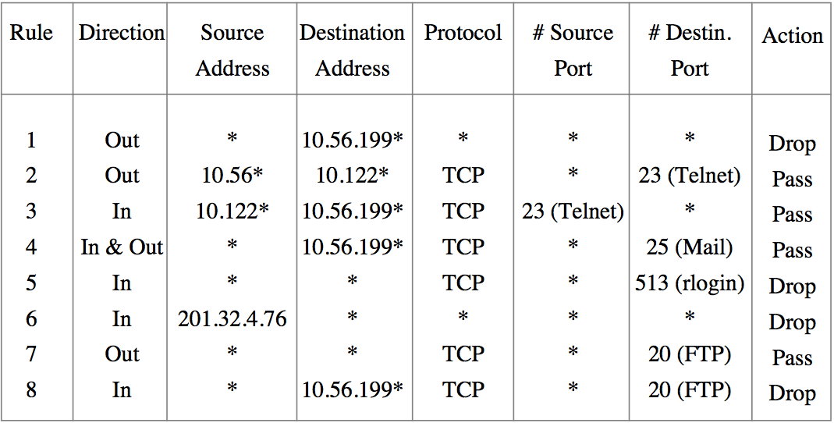
Packet Filtering Policy Example

Slide 16
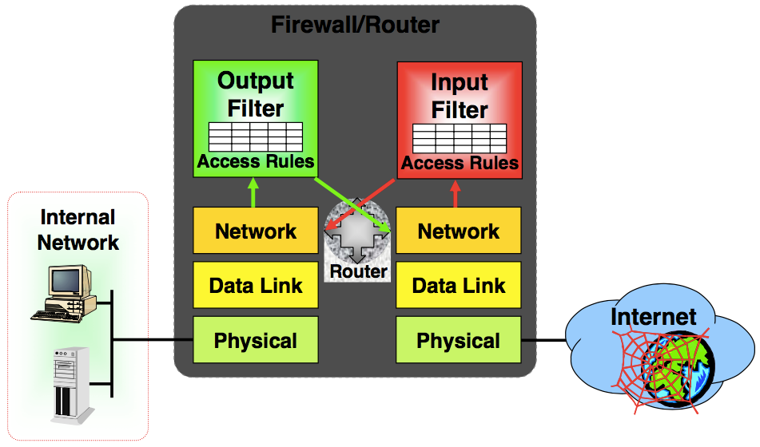
Packet Filtering Firewalls

Slide 17
Packet Filtering Firewalls
Advantages:
Simple, low cost, fast, transparent to user
Disadvantages:
They cannot prevent attacks that employ application- specific vulnerabilities or functions
because they do not examine upper-layer data.
Most packet filter firewalls do not support advanced authentication schemes
due to the lack of upper-layer functionality
It is easy to accidentally configure a packet filtering firewall to allow traffic types, sources, and destinations that should be denied based on an organization’s policy
due to the small number of variables used for decision

Slide 18
Circuit Level Firewalls
Circuit level gateways work at the session layer of the OSI model, or the TCP layer of TCP/IP
Monitor TCP handshaking between packets to determine whether a requested session is legitimate.
Do not permit an end-to-end TCP connection
Rather, the gateway sets up two TCP connections, one between itself and a TCP user on an inner host and one between itself and a TCP user on an outside host.
Once the two connections are established, the gateway typically relays TCP segments from one to the other without examining the contents

Slide 19
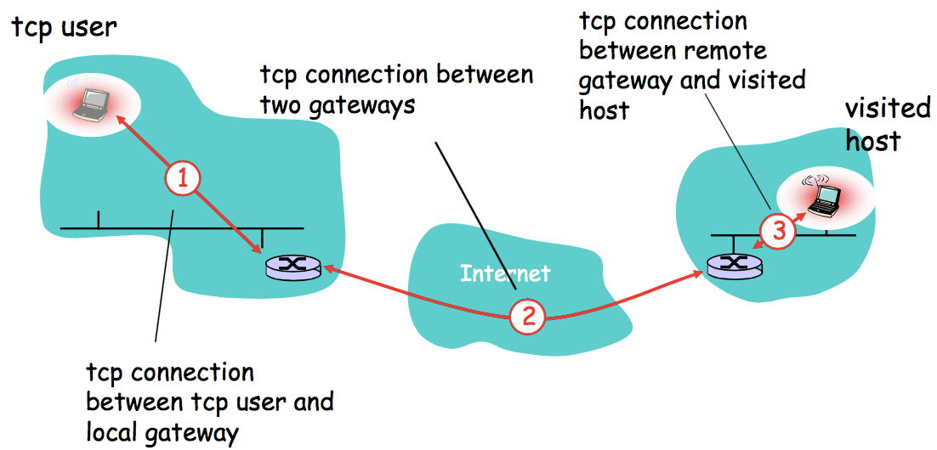
Circuit Level Firewalls Example

Slide 20
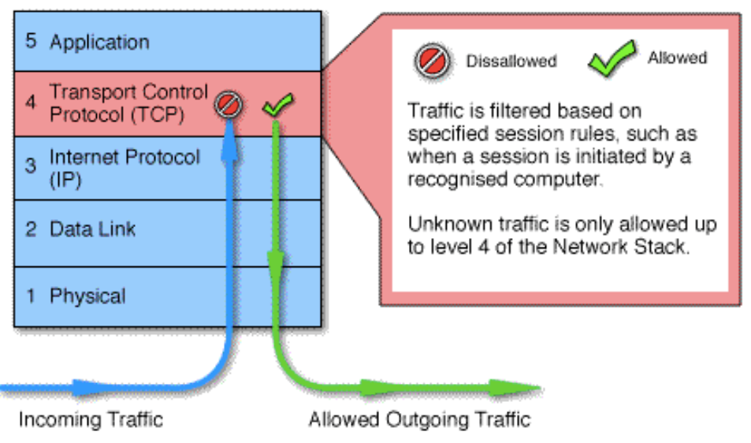
Circuit Level Firewalls

Slide 21
Application Gateway Firewalls
Similar to circuit-level gateways except that they are application specific.
Every connection between two networks is made via an application program called a proxy
Proxies are application or protocol specific
Only protocols that have specific proxies configured are allowed through the firewall; all other traffic is rejected.
E.g., a gateway that is configured to be a web proxy will not allow any ftp, telnet or other traffic through

Slide 22
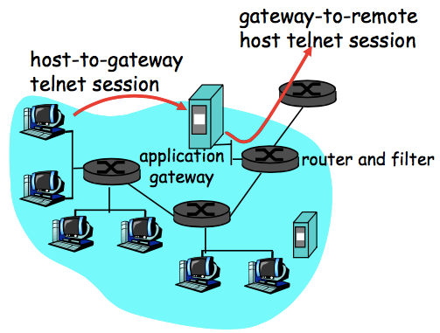
Application gateways
Filters packets on application data as well as on IP/TCP/UDP fields.
host-to-gateway telnet session
Example: allow select internal users to telnet outside.
1. Require all telnet users to telnet through gateway.
2. For authorized users, gateway sets up telnet connection to dest host. Gateway relays data between 2 connections
3. Router filter blocks all telnet connections not originating from gateway.

Slide 23
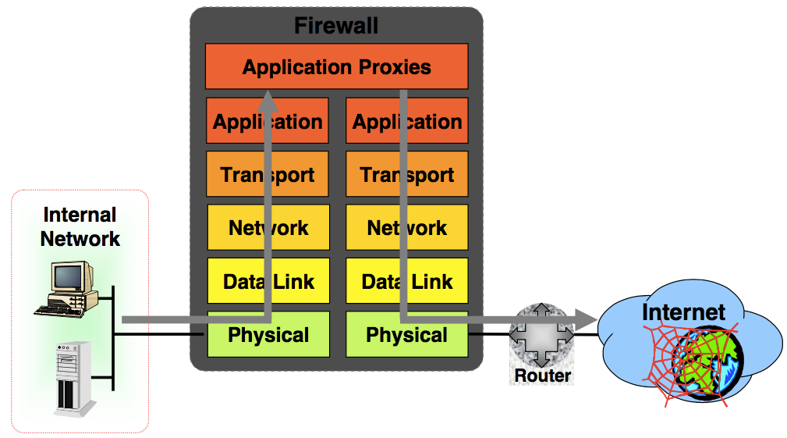
Application Gateway Firewalls

Slide 24
Application Gateway Strengths
More secure than packet filtering firewalls
Rather than trying to deal with the numerous possible combinations that are to be allowed and forbidden at the TCP and IP level, the application gateway need only scrutinize a few allowable applications.
It is easy to log and audit all incoming traffic at the application level.

Slide 25
Application Gateway Weaknesses
Very CPU intensive
There are two spliced connections between the end users, with the gateway at the splice point, and the gateway must examine and forward all traffic in both directions.
Requires high performance host computer Expensive

Slide 26
Stateful Inspection Firewalls
Third generation firewall technology, often referred to as dynamic packet filtering
Understands data in packets from the network layer (IP headers) up to the Application Layer
Tracks the state of communication sessions

Slide 27
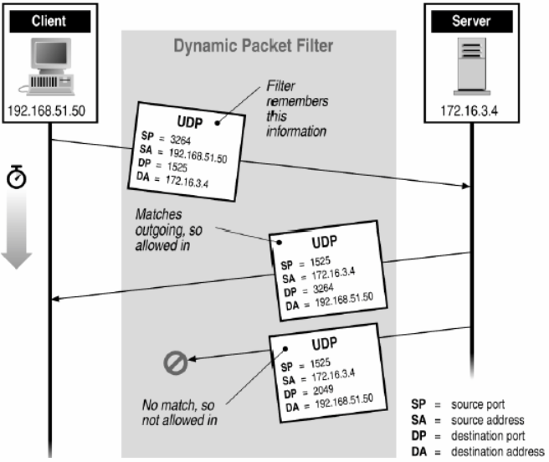
Stateful Inspection Firewalls Example

Slide 28
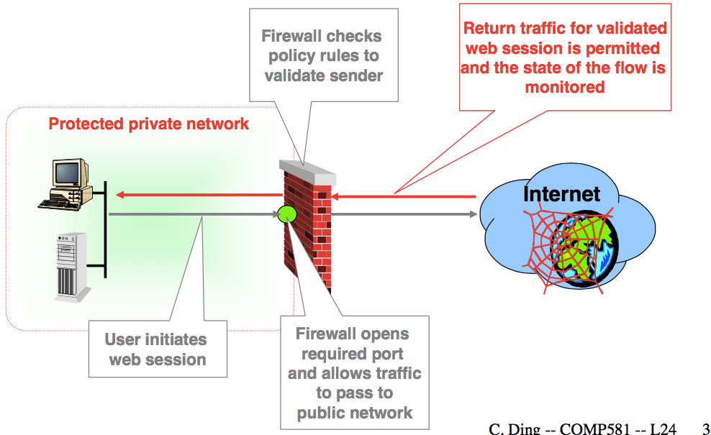
Stateful Inspection Implementation

Slide 29
Stateful Inspection Strengths
Monitors the state of all data flows
Dynamically adapts filters based on defined policies and rules
Easily adapted to new Internet applications
Transparent to users
Low CPU overheads

Slide 30
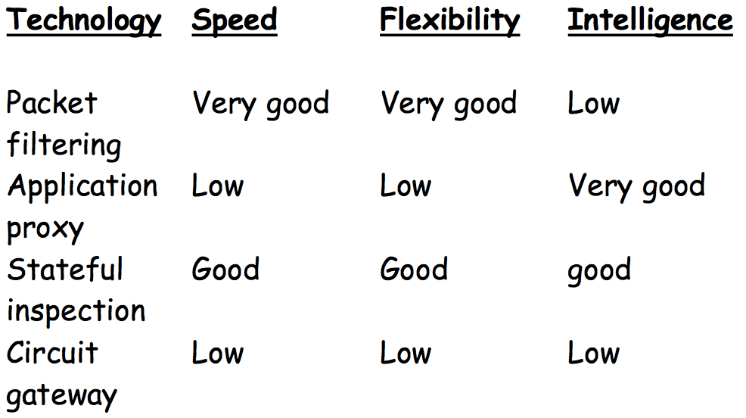
General Performance

Slide 31
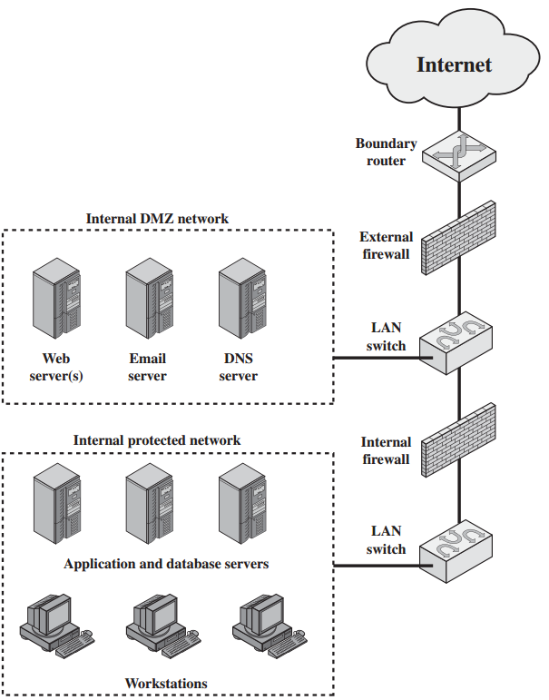
DMZ
DMZ
= Demilitarized
Zone

Slide 32
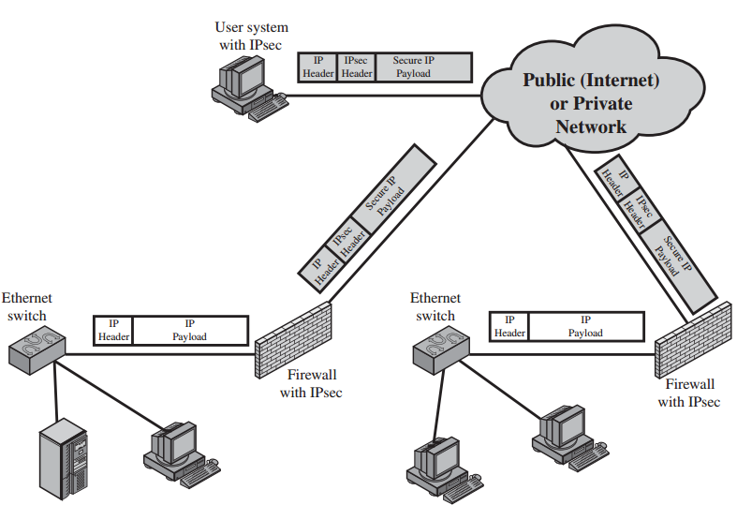
VPN: Virtual Private Network

